Slide 1
Ukraine market review
March 2025

Slide 2
EAST OFFICE IN A NUTSHELL
17 companies & and 1 University with operations on 6 continent and an aggregate turnover over €70 billion
Represents and supports companies' interests in Ukraine and CIS since 2008
High understanding of the business environment and decades of experience in Eastern markets
Provides frequent, reliable, and up-to-date reporting and data to companies
Active contacts with authorities, business leaders, and experts in target markets. East Office helps companies get access to the right people
Forms an exclusive and unique business community in Finland and facilitates its owners' cooperation on experience-sharing
Offers troubleshooting and support in different issues and operative questions
Operates from Helsinki and Kyiv
The Finnish Ministry for Foreign Affairs and the Confederation of Finnish Industries are present in the East Office Board

Slide 3
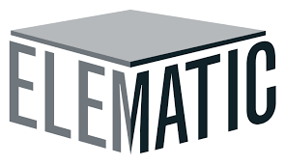
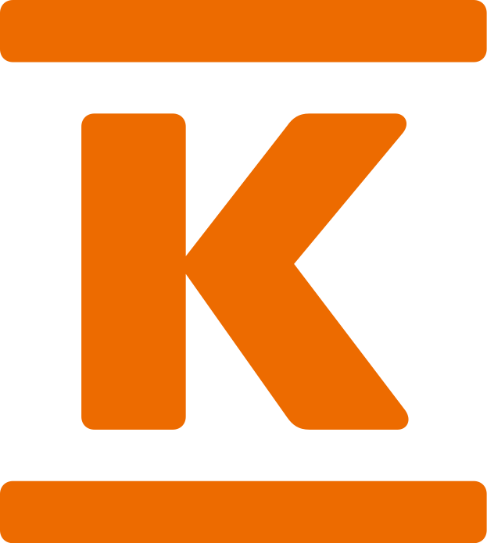
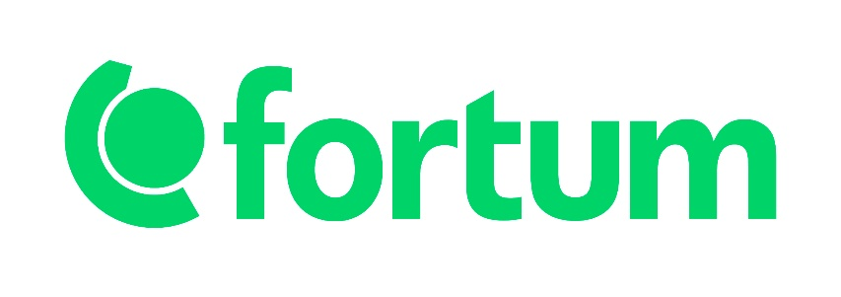
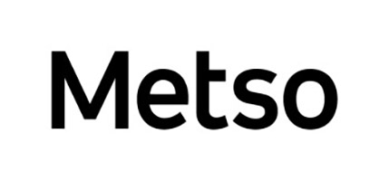
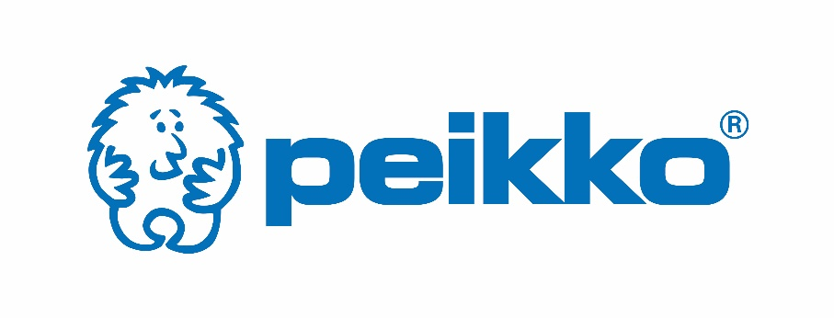
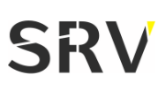
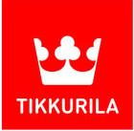
Our Companies

Slide 4
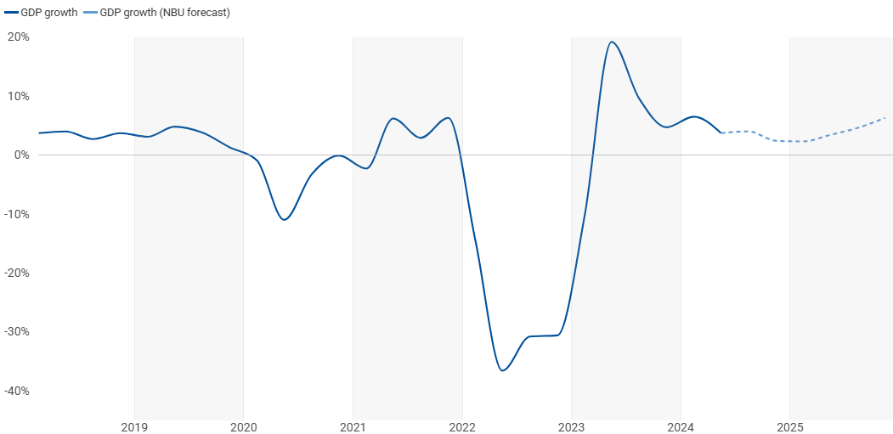
GDP increased by 3.6% in 2024
Gradual recovery: Following the unprecedented -29% contraction in 2022 caused by the war, Ukraine is showing signs of gradual recovery in 2024. While growth remains modest, it signals stabilization driven by adaptive economic mechanisms and external financial support.
Growth drivers are transport and construction, manufacturing, and domestic trade. Lower-than-expected electricity shortages and slightly higher harvests of early grain crops contribute to better GDP recovery.
Domestic demand: Despite ongoing challenges, domestic demand has partially rebounded. This is supported by the reopening of businesses, reconstruction efforts, and moderate recovery in household consumption.
Ukrainian exports have been recovering, albeit gradually. Agricultural exports, a cornerstone of the economy, have resumed through alternative trade routes due to disrupted Black Sea logistics. Industrial exports remain subdued due to damaged infrastructure and manufacturing capacity.
Large-scale reconstruction projects, while critical for growth, face delays due to funding gaps, ongoing conflict in certain areas, and logistical challenges. Private sector participation is increasing but remains limited due to high risks.
Outlook: Ukraine's GDP growth is projected to remain slow but positive in 2025 and beyond, supported by reconstruction and external funding.
Reconstruction and infrastructure rebuilding are expected to become the main drivers of economic activity. These efforts could attract foreign direct investment (FDI) and create jobs, provided that security conditions allow for large-scale projects.
Reviving Ukraine’s agricultural and industrial sectors is essential for sustainable growth. Access to global markets will depend on maintaining and expanding alternative trade routes, as well as rebuilding damaged production facilities.
Key challenges ahead come from ongoing war uncertainty, human capital loss and skilled workforce shortages, energy infrastructure damage and sustainability of the increasing public debt.
GDP change per quarter, y-o-y, %
+19,2%
2023 Q2
+3,6%
2024
+6,4%
2025 F
-36,6%
2022 Q2
Source: Centre for Economic Strategy, State Statistics Service, NBU (forecast)
The World Bank forecast for GDP growth in 2025 is 6.5%.

Slide 5
Foreign aid
In 2024, foreign aid was on a stable level, despite a pause from the USA financing.
Since the beginning of the full-scale invasion, all of Ukraine’s own state budget revenues have been used to finance defence, accounting for approximately half of the state budget. All civilian expenditures of the state budget are financed by foreign financial assistance – in 2024, the need for such external financing was $38 billion.
Since the beginning of the war, the total committed foreign aid is 430 billions USD, out of which 287 billions USD have been allocated and 143 billions USD still undrawn, which is also a booster to the economy.
The foreign aid is predominantly given in the form of loans.
The largest amount has come from EU. In 2024 this continued almost on par of the 2023 levels. Total EU aid has been 122 billions USD since the start of the war and total commitment reaches 218 billions USD, leaving 96 billions USD still to be drawn.
USA has been the 2nd largest contributor and has financed mostly in the form of grants instead of loans. In the beginning of the year, the financing was stopped. However, then US Congress passed a large package of assistance to Ukraine and as the result the total annual financing came close to 2023 levels. So far the total aid has amounted to 114 billions USD. Recent development regarding US financing has been Trump suspending the further aid.
The overall total foreign financing as the result was on a stable level compared to the last year – without the domestic bonds, there was a -2% decrease in total financing. Together with the domestic bonds, however, the total financing increased by +35%.
In 2025, following the suspension of US aid to Ukraine, European Union (EU) countries and allies have announced significant new commitments to support Ukraine across defense, financial, and humanitarian sectors.
EU Defense Initiative: ReArm Europe:
On March 4, 2025, European Commission President Ursula von der Leyen unveiled the "ReArm Europe" plan, aiming to mobilize up to €800 billion to bolster Europe's defense capabilities. This comprehensive strategy includes €150 billion in loans for joint procurement of defense equipment, alongside measures to enhance fiscal flexibility and private investment in the defense sector. The initiative addresses the urgent need to strengthen European defense in light of reduced US support for Ukraine.
Individual Country Commitments:
Norway: In response to pressures to increase support for Ukraine, Norway announced plans to double its aid, pledging an additional $8.1 billion. Discussions are ongoing about utilizing the nation's $1.8 trillion sovereign wealth fund to further support these efforts.
United Kingdom: At the 2025 London Summit on Ukraine, Prime Minister Keir Starmer committed £1.6 billion ($2 billion) in export financing to procure over 5,000 air defense missiles for Ukraine. This is in addition to a previously announced £2.2 billion loan for military aid, funded by frozen Russian assets.
Germany: Germany has indicated plans to enhance its defense spending, aligning with broader EU efforts to increase military capabilities. Specific figures are yet to be detailed, but the commitment underscores Germany's role in the collective European defense strategy.
France: France has proposed extending its nuclear deterrent to cover EU allies, reflecting a significant shift in defense policy aimed at strengthening collective security within Europe.
Source: Centre for Economic Strategy (2023, 2024), Ministry of Finance of Ukraine, Kiel institute for the World economy

Slide 6
Inflation initially slowed down from 2023 peak levels but continued to accelerate again in 2024 H2
CPI and key components, y-o-y, %
CPI
Foods
Clothing
Housing and utilities
Furnishing and appliances
26,6%
26,6%
Transport
24,6%
26,5%
26,0%
24,9%
22,2%
23,8%
21,5%
21,3%
16,4%
18,0%
17,9%
13,7%
15,3%
11,0%
10,9%
10,7%
12,8%
11,3%
11,2%
12,0%
12,9%
8,5%
8,4%
9,5%
9,5%
10,2%
10,2%
10,3%
10,0%
10,0%
8,6%
8,6%
9,7%
7,5%
7,1%
7,5%
6,1%
5,3%
5,1%
5,1%
4,7%
4,3%
4,8%
5,4%
3,2%
3,2%
3,3%
21/01
21/02
21/03
21/04
21/05
21/06
21/07
21/08
21/09
21/10
21/11
21/12
22/01
22/02
22/03
22/04
22/05
22/06
22/07
22/08
22/09
22/10
22/11
22/12
23/01
23/02
23/03
23/04
23/05
23/06
23/07
23/08
23/09
23/10
23/11
23/12
24/01
24/02
24/03
24/04
24/05
24/06
24/07
24/08
24/09
24/10
24/11
24/12
25/01
Source: State Statistics Service
Overall CPI inflation slowed down significantly from 2023 peak levels and reached +3,2% level in April 2024, reflecting better supply chain conditions and relative stability of the hryvnia. However, the inflation has accelarted again in 2024 H2 driven by the food prices and housing.
Housing and utilities component is on a high level since June 2023, reaching 19,1% in January 2025.
Food prices, which was the key driver of high inflation during 2021-2023H1, initially stabilized to -0,5% level by April 2024 but accelerated again to 14,3% by January 2025.

Slide 7
Corruption in Ukraine
Score
35/100 (-1)
Vital Pillars for Tackling
Corruption
PEOPLE
The full-scale war has significantly reduced the tolerance for corruption among the common people, who have suffered considerably. Ukraine is a democracy where the regime is compelled to heed the sentiments of its people, exemplified notably by movements like the Maidan uprising.
Ranking
105/104 (-1)
INTERNATIONAL FUNDING
the critical role of the international community, particularly Western nations, in supporting the Ukrainian economy. The support is subject to proper governance, a fact well understood by the Ukrainians.
TRANSPARENT INTERNATIONAL RANKING 2024
In the 2024 Corruption Perceptions Index (CPI), Ukraine received a score of 35 out of 100, positioning the country at 105th out of 180 countries.
In the last 2 years, however, Ukraine’s score has improved by +2 points and ranking from the 116th position to the 105th.
Still behind even the lowest performing EU countries (Hungary (41), Bulgaria (43), and Romania (46)), but ahead of its EU candidate countries Bosnia & Herzegovina (33) and Turkey (34). Way ahead of Russia (22).
For reference, number one in ranking Denmark has a score of 90, and second Finland has 88.
WISH TO JOIN EU
A widespread aspiration among Ukrainians to align with Western values and norms, as opposed to Eastern, Soviet-style governance. EU membership candidacy holds significant importance, symbolizing a desire for integration into the Western world. The clear understanding is that the old governance is an obstacle for membership, and they need to "wash their hands before the invitation to the EU dinner table is received."

Slide 8
Understanding Corruption Risks: A Breakdown of Business Segments
LOWER RISK
HIGHER RISK
B2C
LARGE PUBLIC PROCESSES
Risk Level: Low risk, unlikely to happen
In business-to-consumer transactions, the risk of encountering corruption is minimal.
B2B
B2B TO PUBLIC SECTOR SALE
LARGE PUBLIC PROJECTS WITH INTERNATIONAL FINANCIAL INSTITUTIONS INVOLVEMENT
B2R, BUSINESS TO RETAILER
Risk Level: quite likely to happen
Due to their scale and complexity, often involve significant amounts of public funds and multiple stakeholders. This makes them susceptible to corruption
Risk Level: Low risk, unlikely to happen
In business-to-business transactions, the risk of encountering corruption is generally low
LARGE PUBLIC PROJECTS WON THROUGH PROZORRO*
Risk Level: possible
there's a risk that the partner may request to participate in corrupt schemes, such as demanding kickbacks or bribes to secure contracts.
Risk Level: possible but not very likely
the risk of encountering corruption is relatively low. However, there may still be cases where an officer of the retailer requests additional payments or "shelf fees" for preferential treatment.
Risk Level: Reduced risk, unlikely to happen
When large public projects involve international financial institutions, such as the World Bank or EBRD, there tends to be greater oversight and transparency, which reduces the risk of corruption.
Risk Level: low, possible only during pre-tendering or monitoring phases
While participation through Prozorro significantly enhances transparency and fairness, there may still be opportunities for corruption before or after the tendering phase
*prozorro
The Prozorro system, a governmental portal, serves as a central platform for announcing tender processes for the majority of large public sector projects in Ukraine. However, navigating the system can be complex, often requiring local expertise and support for successful participation. While East Office is contemplating offering follow-up services, there has been limited interest among its companies thus far. Alternatively, companies like Accountor, among a few others, are willing to provide monitoring and processing services to interested parties.

Slide 9
Risk Management
Ukrainian markets lack stringent regulations and transparency compared to Nordic markets, making it challenging to prevent unfair practices and deceptive advertising.
Establishing mutually beneficial business relationships and avoiding over-reliance on a few partners are essential strategies for achieving justice and mitigating risks in the unpredictable Ukrainian market.
The presence of a grey market for products in Ukraine, including relabeled unofficial imports sold as premium goods, distorts the market and requires vigilance to uphold ethical standards.
Despite challenges, Ukrainian markets hold promising potential for Finnish, Nordic, and EU enterprises, necessitating careful partner selection and incremental progress to maintain governance principles.
Mid-size Finnish businesses often start selling through dealers before establishing in-house sales forces and localized distribution networks, with comprehensive insurance coverage informing strategic decisions.
RISK MITIGATION IN UKRAINE
STEP BY STEP
keeping the capex on a reasonable level
clear in advance communications of the code of conduct
incremental progress
Careful partner selection
4
3
2
1

Slide 10
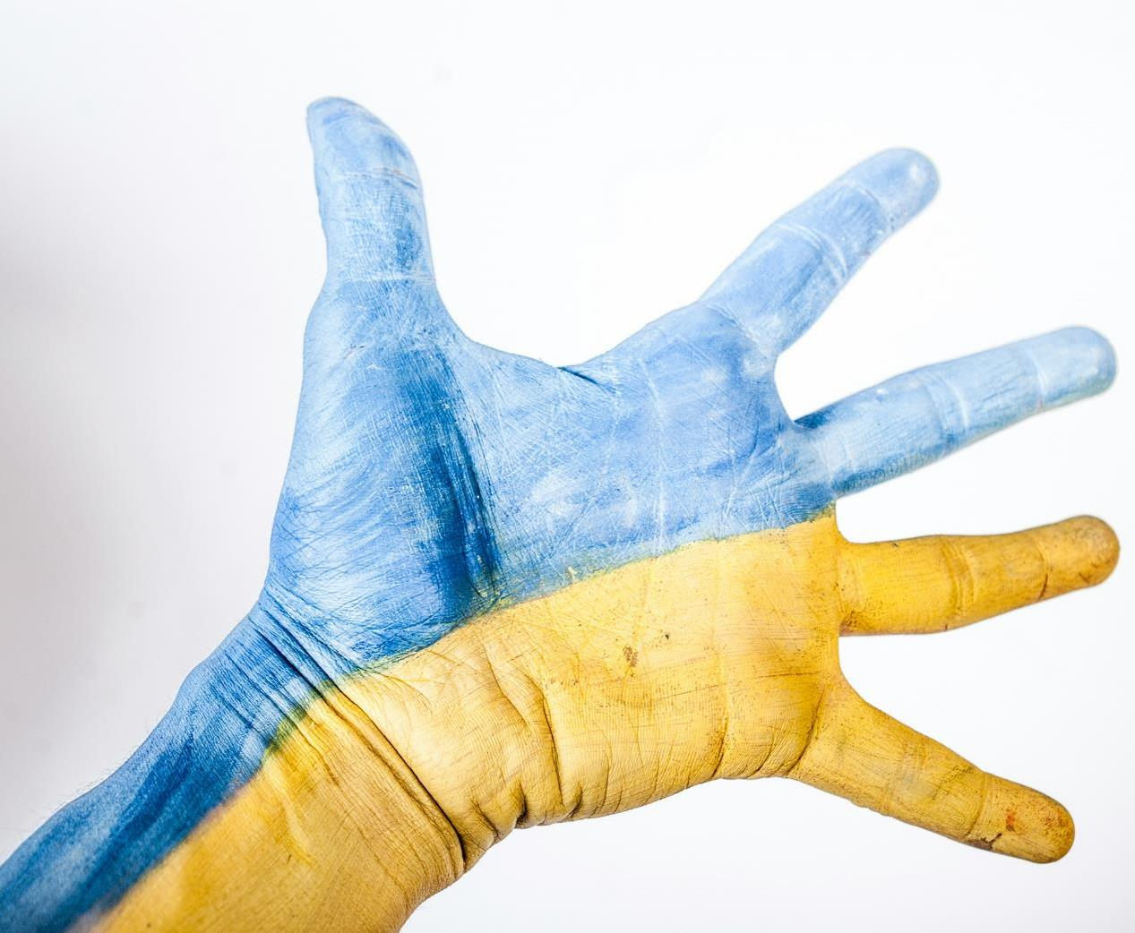
Nordic approach
Insights gleaned from interviews with enterprises suggest that navigating the challenges without compromising governance principles is possible – The key lies in careful partner selection, incremental progress, and keeping the capex on a reasonable level.
The prevailing approach among mid-size Finnish businesses involves selling through dealers. Many companies from the construction and construction materials sector as well as companies from apparel retail, automotive and food sectors are already present or in process of engaging local staff. The companies appreciate the potential over the risks.
The availability of comprehensive insurance coverage plays a crucial role in informing this strategic decision-making process.

Slide 11
Potential outcome scenarios
Finland Sept 1944
Fully sovereign, territory regained
US support ended
Russian-friendly US approach
Weak EU
Strong Eastern alliance
No sustainable nor just peace
Ukraine herself:
Strong army
Natural resources
Taste of freedom / prosperity
Türkiye:
Strong regional player
Ukraine natural resources + rebuild business
Not like Russian influence increase
Trump:
Monopolized peace negotiations
Failure → his failure
Failure leads to loss of face on the global scene
EU financial support

